Slide 1

VALLURUPALLI NAGESWARA RAO VIGNANA JYOTHI INSTITUTE OF ENGINEERING AND TECHNOLOGY
Department of Computer Science and Engineering
Underfitting and Overfitting
MACHINE LEARNING
Dr. Kriti Ohri
Assistant Professor
Department of Computer Science and Engineering

Slide 2
Underfitting and Overfitting

Slide 3
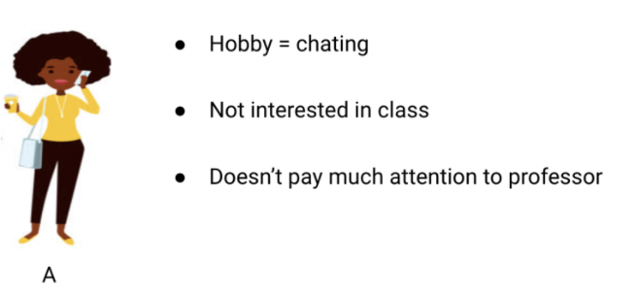
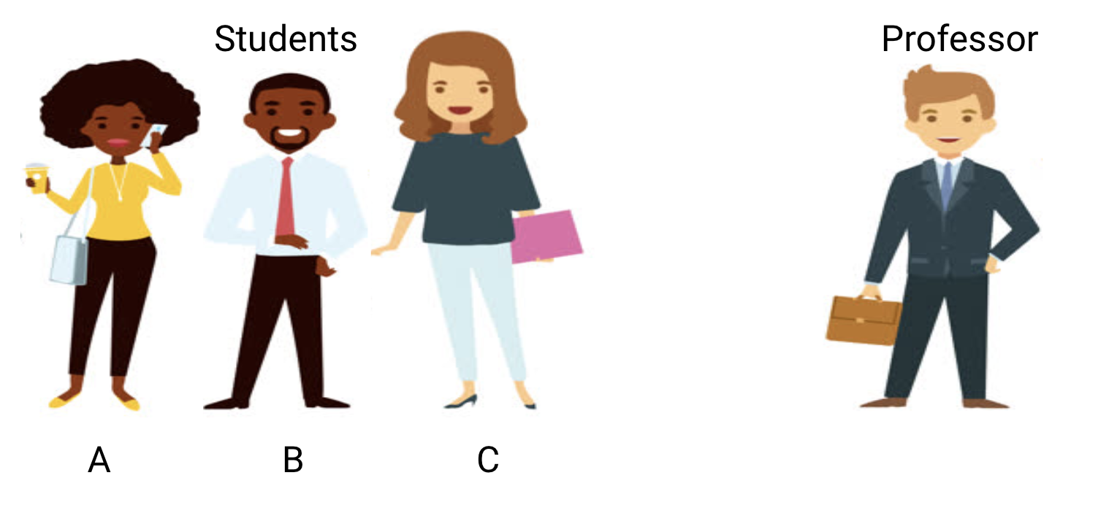
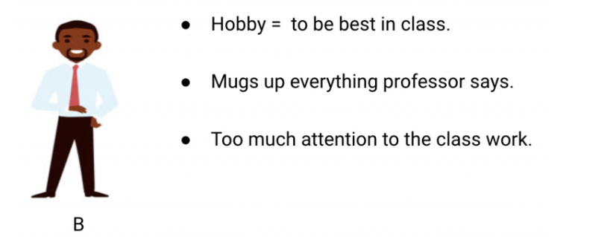
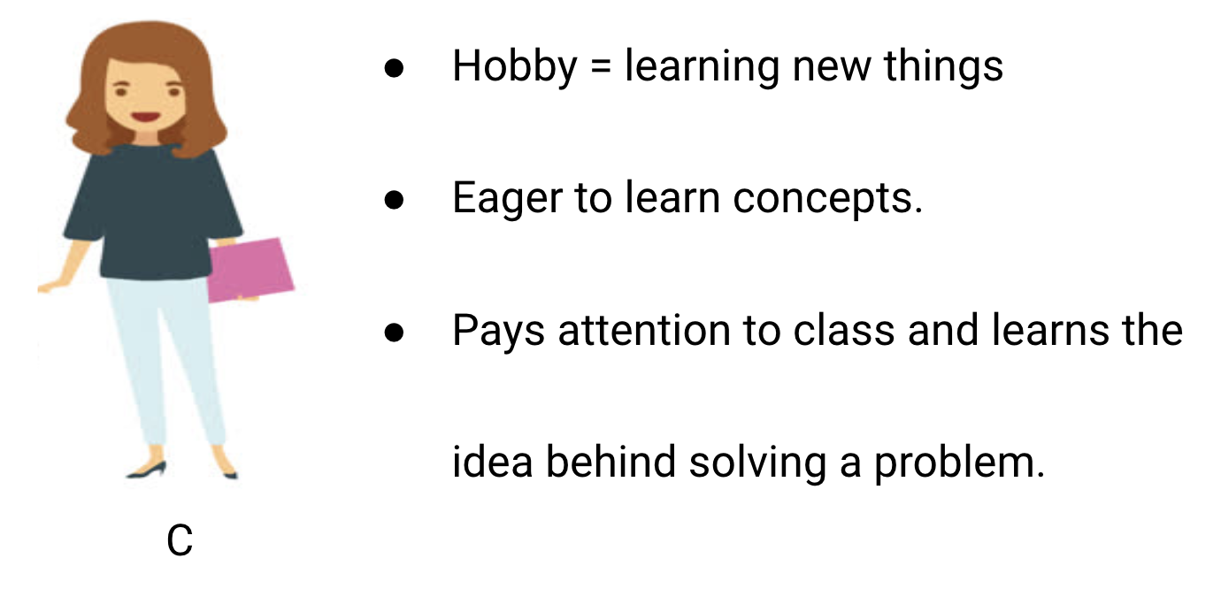
Let’s Take an Example to Understand Underfitting vs. Overfitting

Slide 4
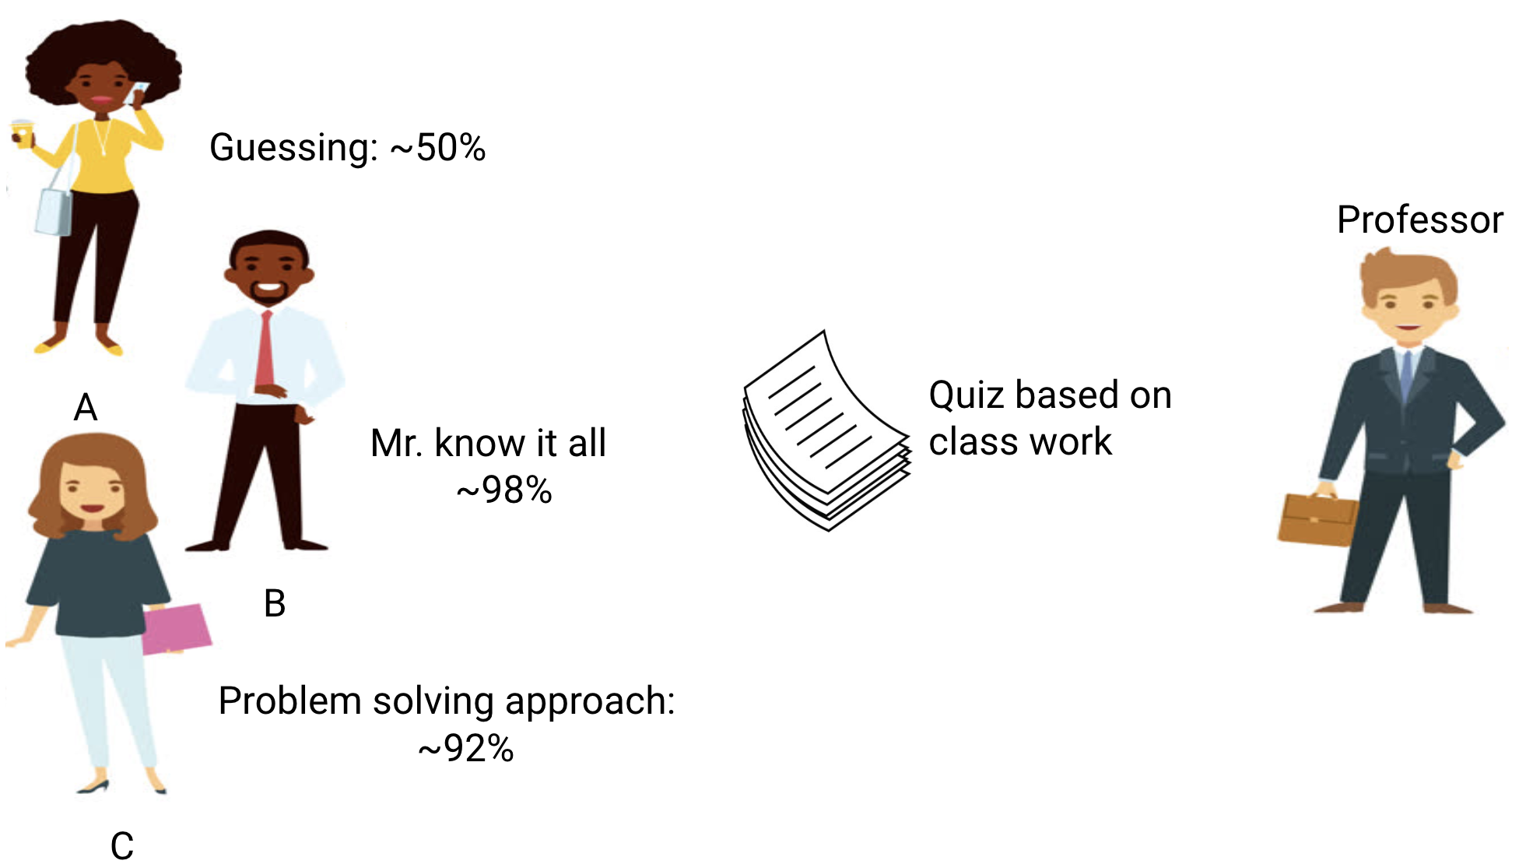

Slide 5
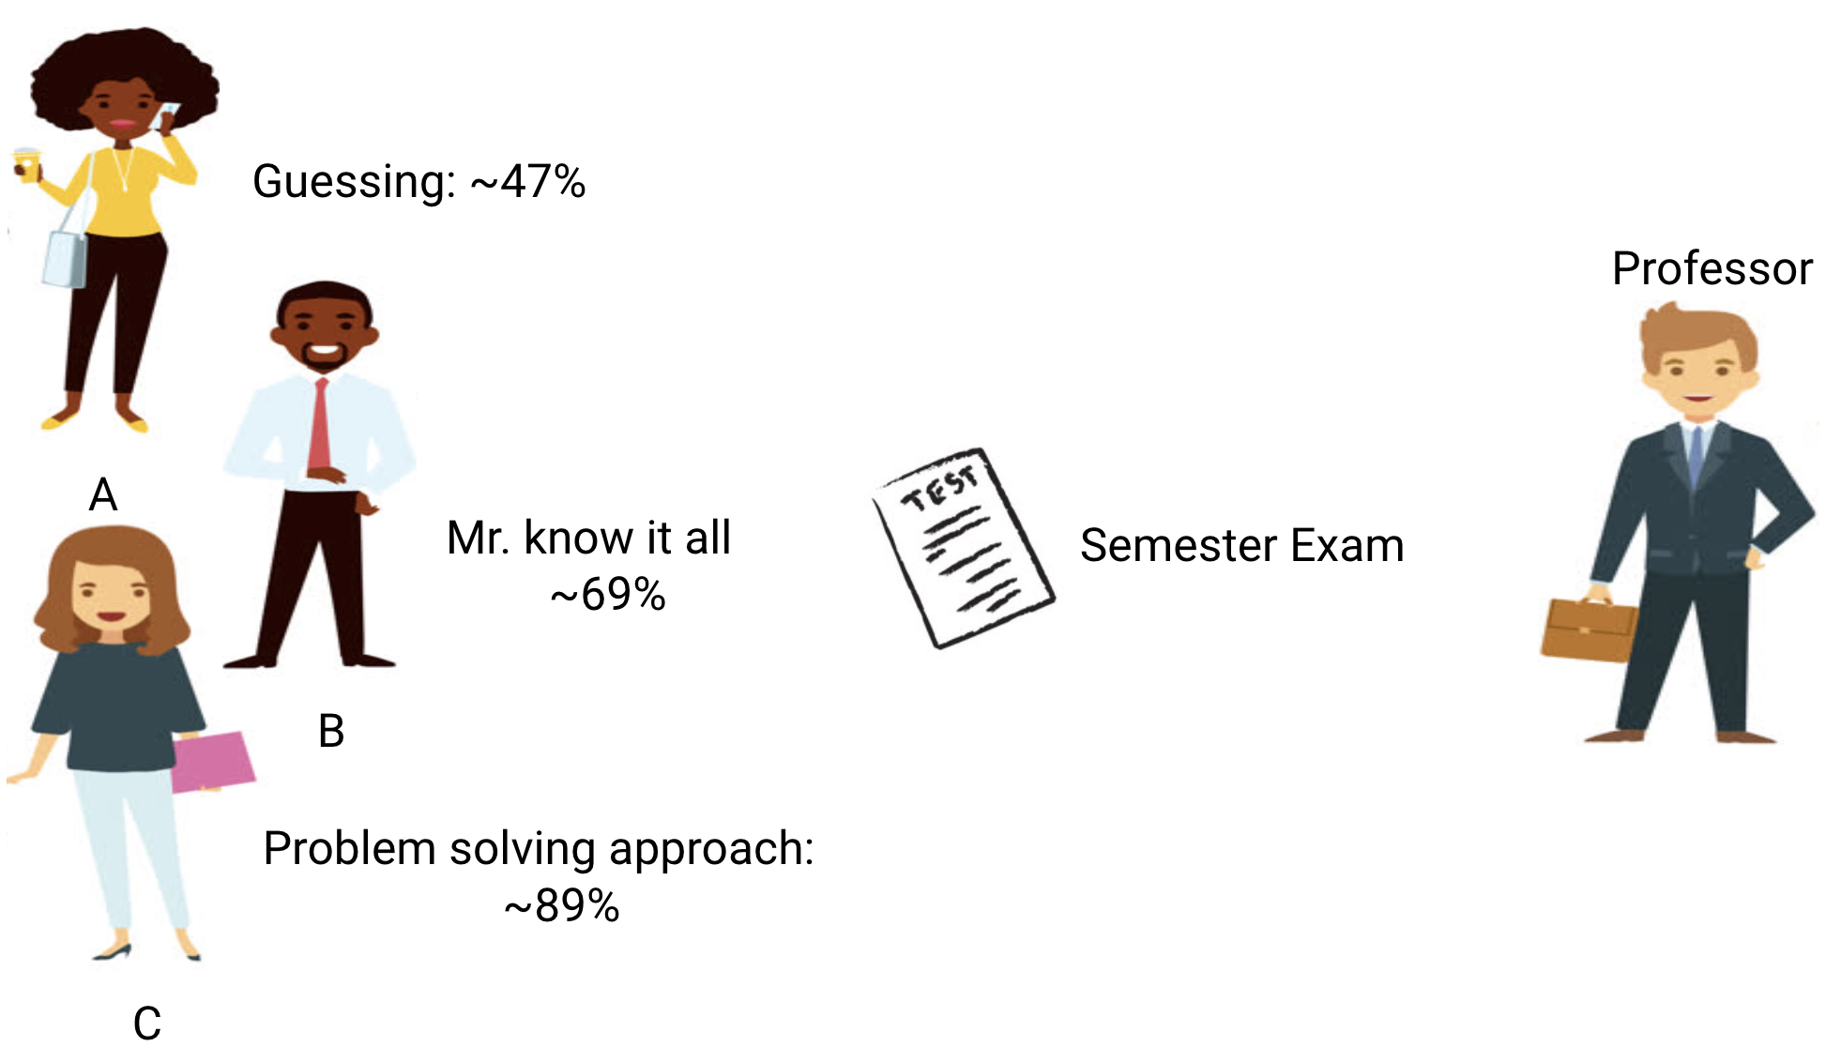

Slide 6
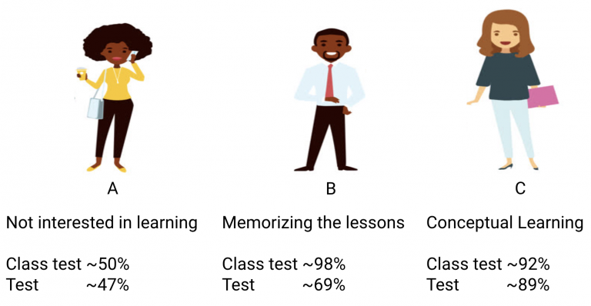
How Does this Relate to Underfitting and Overfitting in Machine Learning?

Slide 7
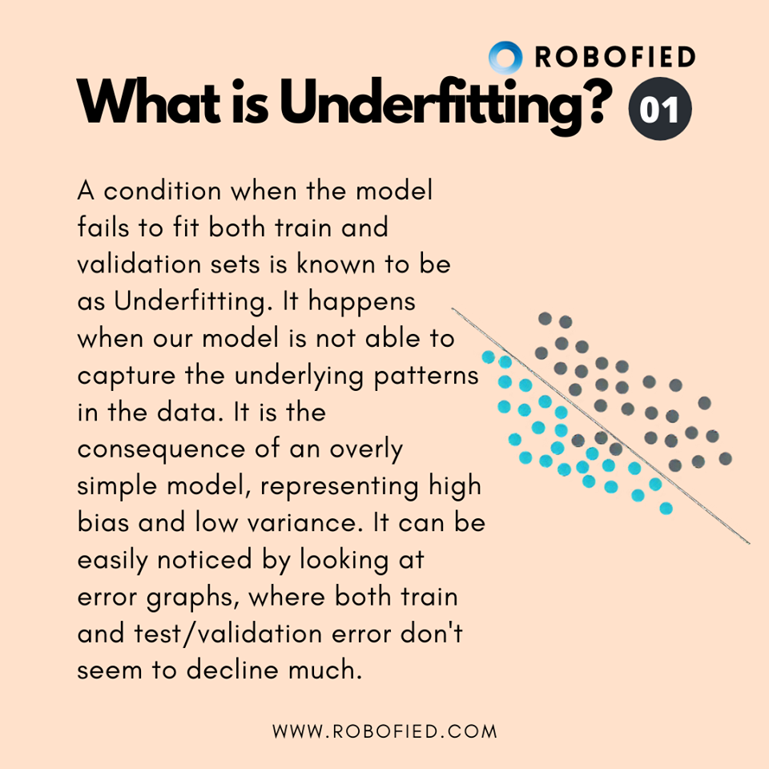
Underfitting

Slide 8
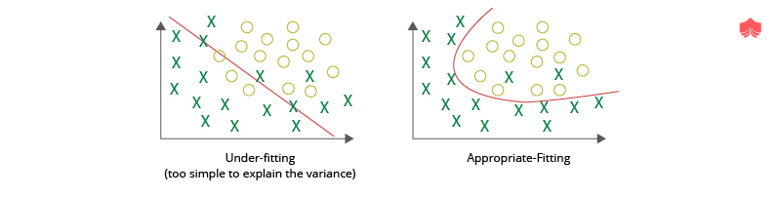
Classification:

Slide 9
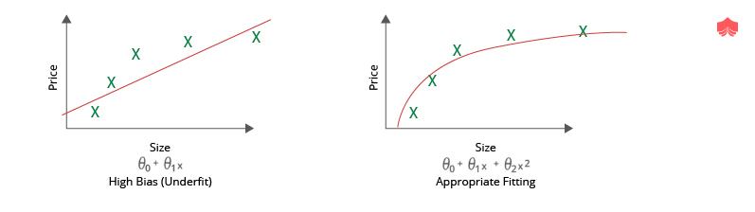
Regression

Slide 10
if the model is performing poorly over the test and the train set, then we call that an underfitting model. An example of this situation would be building a linear regression model over non-linear data

Slide 11
Detection of underfitting model:
Training and Validation Loss: During training and validation, it is important to check the loss that is generated by the model. If the model is underfitting, the loss for both training and validation will be significantly high. In terms of Deep Learning, the loss will not decrease at the rate that it is supposed to if the model has reached saturation or is underfitting.
Over Simplistic Prediction Graph: If a graph is plotted showing the data points and the fitted curve, and the curve is over-simplistic (as shown in the image above), then the model is suffering from underfitting. A more complex model is to be tried out.
Classification: A lot of classes will be misclassified in the training set as well as the validation set. On data visualization, the graph would indicate that if there was a more complex model, more classes would have been correctly classified.
Regression: The final “Best Fit” line will fail to fit the data points in an effective manner. On visualization, it would clearly seem that a more complex curve can fit the data better.

Slide 12
Fix for an underfitting model:
Train Longer: Since underfitting means less model complexity, training longer can help in learning more complex patterns. This is especially true in terms of Deep Learning.
Train a more complex model: The main reason behind the model to underfit is using a model of lesser complexity than required for the data. Hence, the most obvious fix is to use a more complex model. In terms of Deep Learning, a deeper network can be used.
Obtain more features: If the data set lacks enough features to get a clear inference, then Feature Engineering or collecting more features will help fit the data better.
Decrease Regularization: Regularization is the process that helps Generalize the model by avoiding overfitting. However, if the model is learning less or underfitting, then it is better to decrease or completely remove Regularization techniques so that the model can learn better.
New Model Architecture: Finally, if none of the above approaches work, then a new model can be used, which may provide better results.

Slide 13
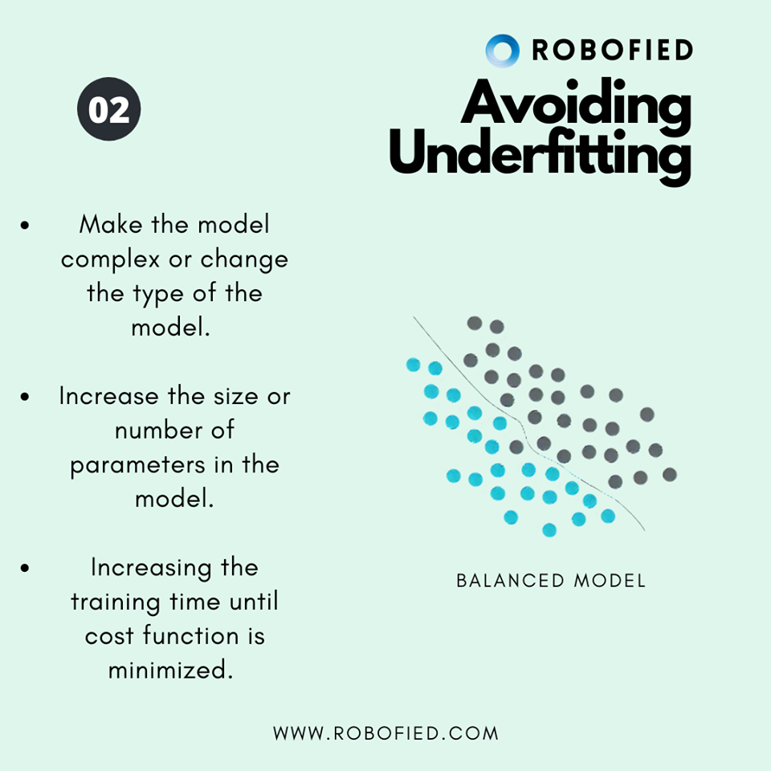
How to avoid underfitting

Slide 14
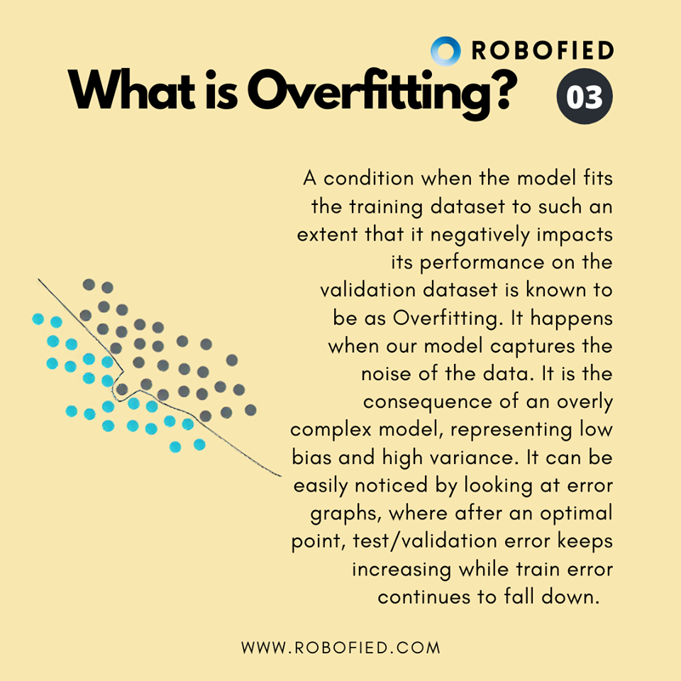
Overfitting

Slide 15
Overfitting
When the complexity of the model is too high as compared to the data that it is trying to learn from, the model is said to “Overfit”. In other words, with increasing model complexity, the model tends to fit the Noise present in data (eg. Outliers). The model learns the data too well and hence fails to Generalize. Overfitting occurs for a model with High Variance and Low Bias.

Slide 16
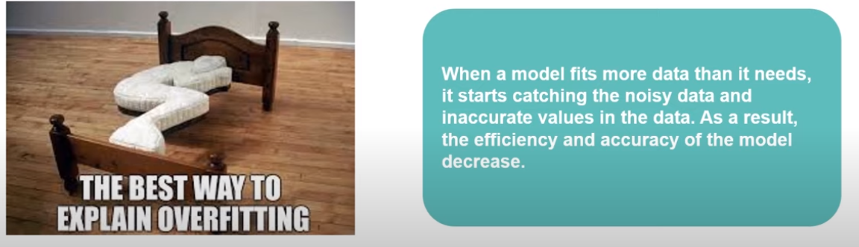
Overfitting

Slide 17
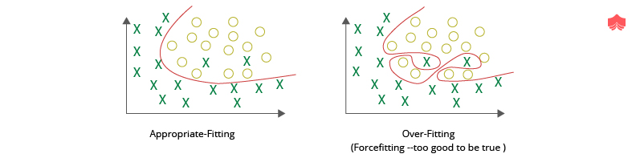
Classification

Slide 18
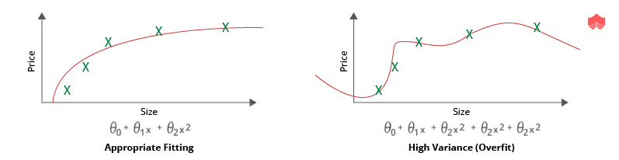
Regression

Slide 19
Detection of overfitting model: The parameters to look out for to determine if the model is overfitting or not is similar to those of underfitting ones. These are listed below:
Training and Validation Loss: As already mentioned, it is important to measure the loss of the model during training and validation. A very low training loss but a high validation loss would signify that the model is overfitting. Additionally, in Deep Learning, if the training loss keeps on decreasing but the validation loss remains stagnant or starts to increase, it also signifies that the model is overfitting.
Too Complex Prediction Graph: If a graph is plotted showing the data points and the fitted curve, and the curve is too complex to be the simplest solution which fits the data points appropriately, then the model is overfitting.
Classification: If every single class is properly classified on the training set by forming a very complex decision boundary, then there is a good chance that the model is overfitting.
Regression: If the final “Best Fit” line crosses over every single data point by forming an unnecessarily complex curve, then the model is likely overfitting.

Slide 20
Fix for an overfitting model:
If the model is overfitting, the developer can take the following steps to recover from the overfitting state:
Early Stopping during Training: This is especially prevalent in Deep Learning. Allowing the model to train for a high number of epochs (iterations) may lead to overfitting. Hence it is necessary to stop the model from training when the model has started to overfit. This is done by monitoring the validation loss and stopping the model when the loss stops decreasing over a given number of epochs (or iterations).
Train with more data: Often, the data available for training is less when compared to the model complexity. Hence, in order to get the model to fit appropriately, it is often advisable to increase the training dataset size.
Train a less complex model: As mentioned earlier, the main reason behind overfitting is excessive model complexity for a relatively less complex dataset. Hence it is advisable to reduce the model complexity in order to avoid overfitting. For Deep Learning, the model complexity can be reduced by reducing the number of layers and neurons.
Remove features: As a contrast to the steps to avoid underfitting, if the number of features is too many, then the model tends to overfit. Hence, reducing the number of unnecessary or irrelevant features often leads to a better and more generalized model. Deep Learning models are usually not affected by this.
Regularization: Regularization is the process of simplification of the model artificially, without losing the flexibility that it gains from having a higher complexity. With the increase in regularization, the effective model complexity decreases and hence prevents overfitting.
Ensembling: Ensembling is a Machine Learning method which is used to combine the predictions from multiple separate models. It reduces the model complexity and reduces the errors of each model by taking the strengths of multiple models. Out of multiple ensembling methods, two of the most commonly used are Bagging and Boosting.

Slide 21
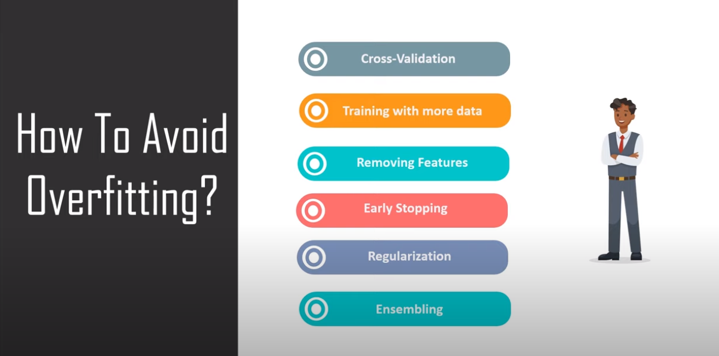

Slide 22
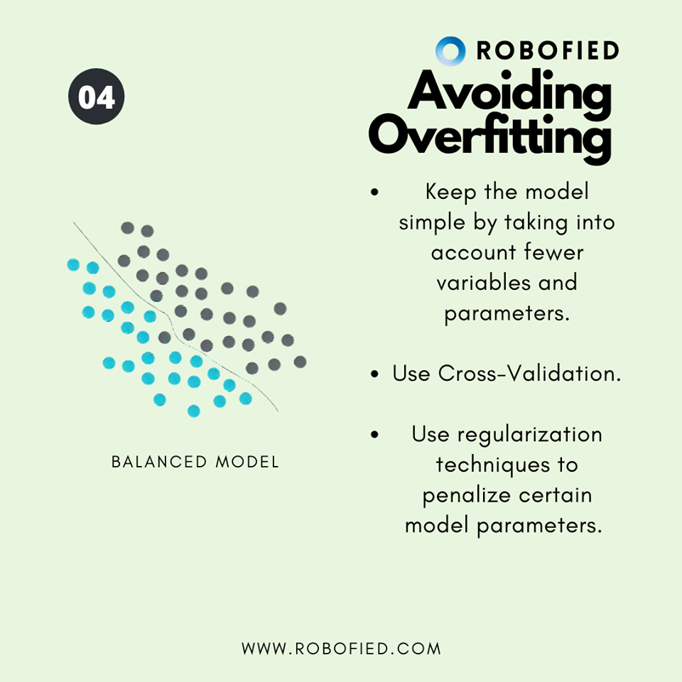
How to avoid overfitting

Slide 23
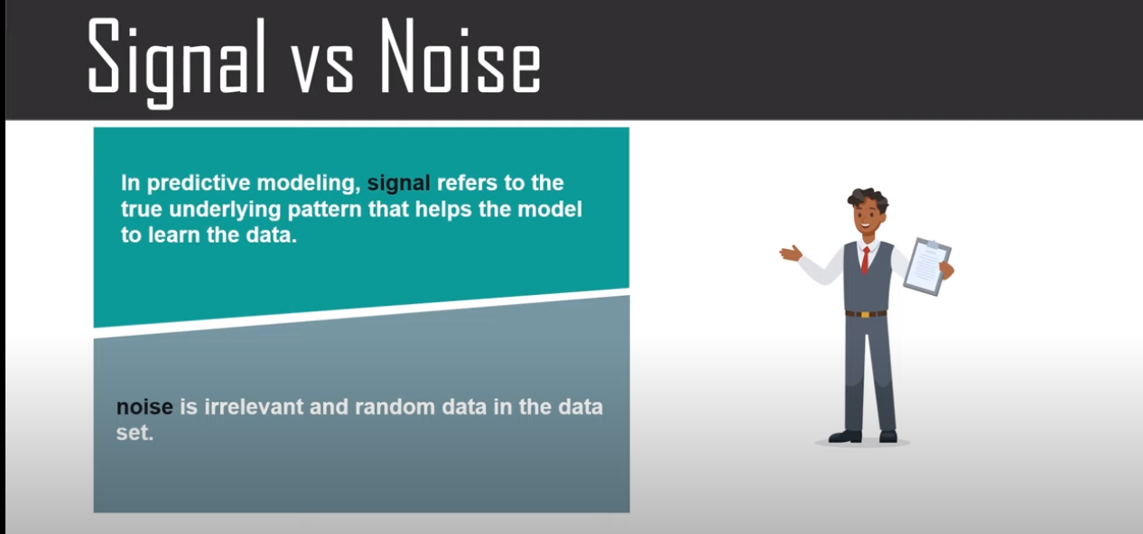

Slide 24
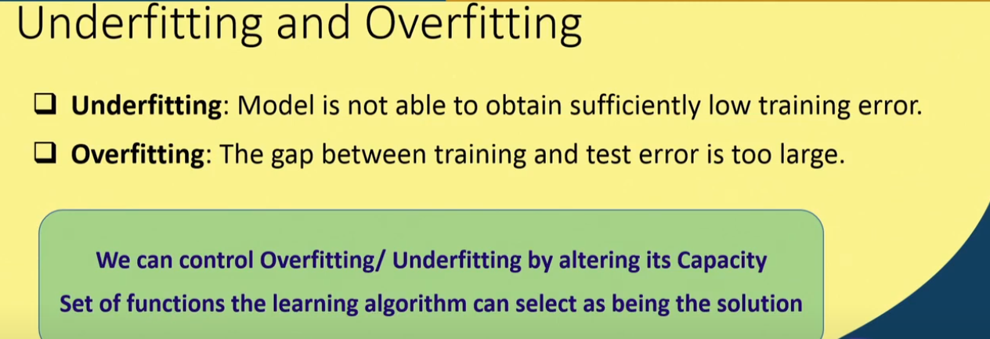

Slide 25
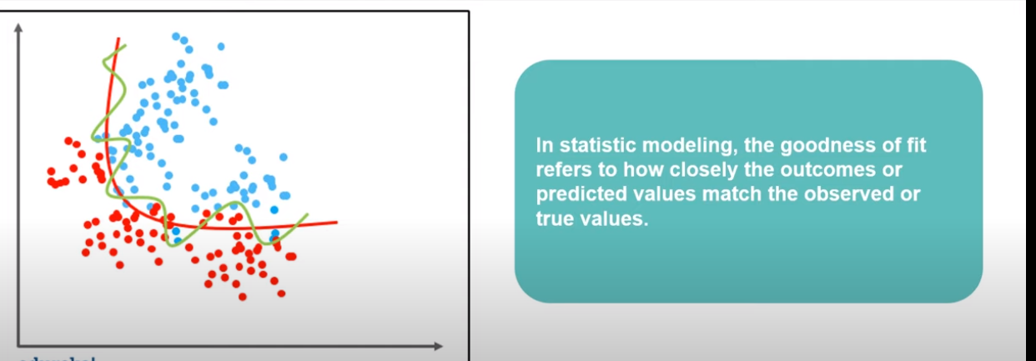

Slide 26
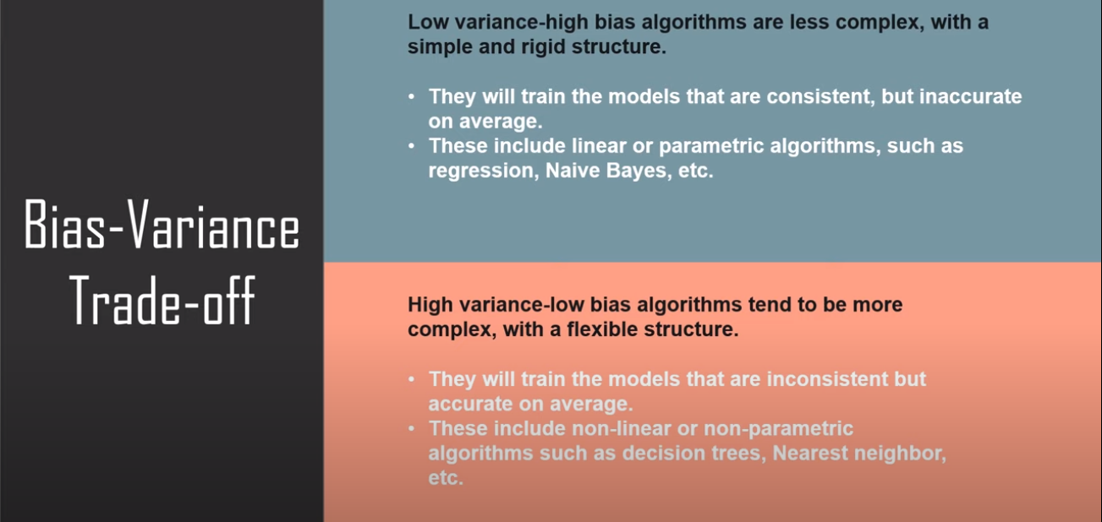

Slide 27
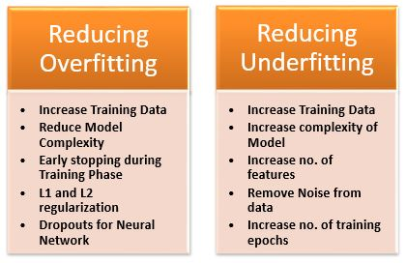

Slide 28
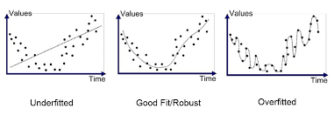

Slide 29
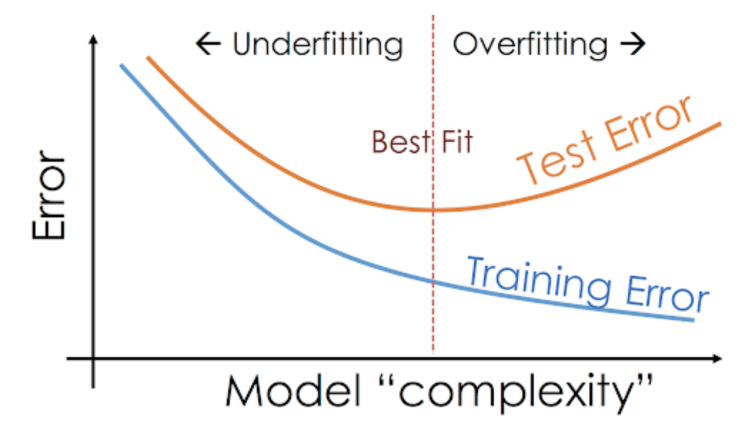

Slide 30
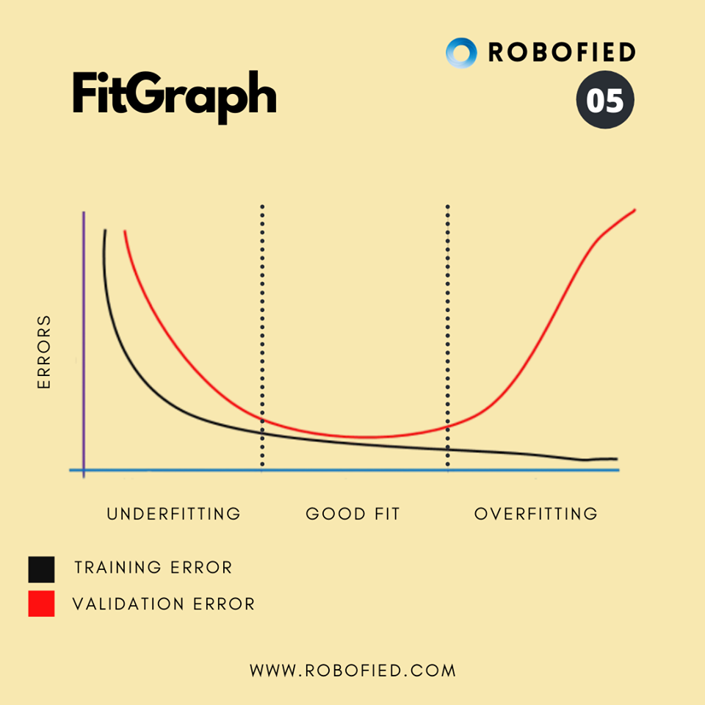

Slide 31
Machine Learning: What Is Overfitting and Underfitting? (knowledgehut.com)

